Slide 1
AWS Workspace Protection

Slide 2
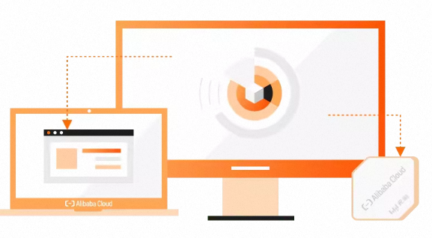




Ali workspace with cen-tr security inspection
无影VPC
VSwitch
VSwitch
attachment
VSwitch
Sec-vpc
云企业网
CEN-TR
TR
attachment
VSwitch
FortiGate NGFW
Internet

Slide 3
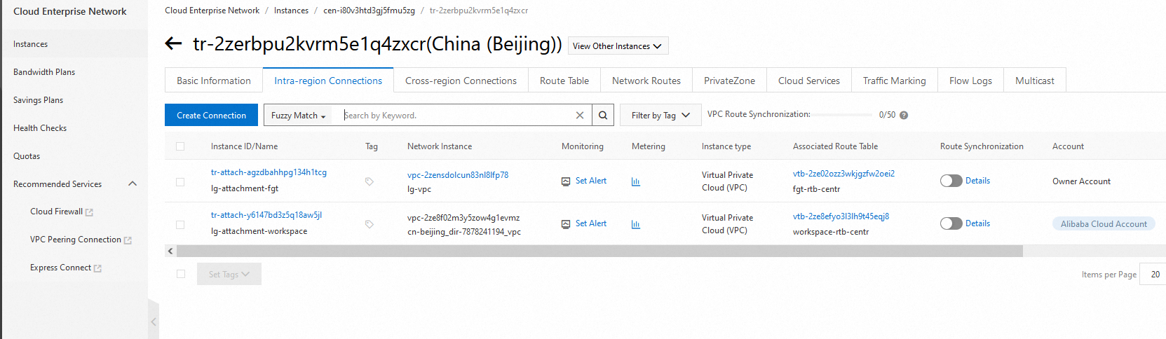
CEN-TR-1

Slide 4
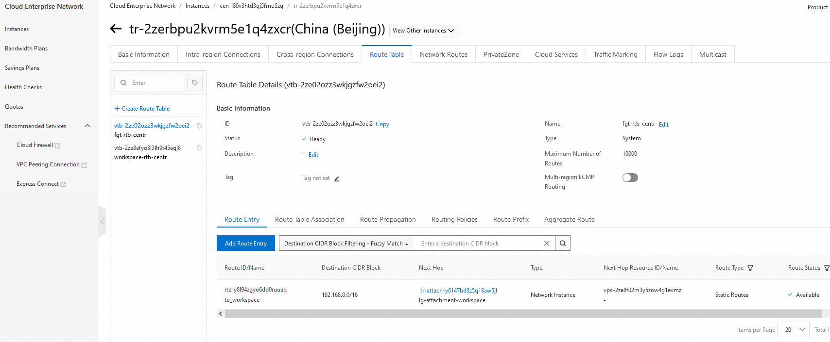
CEN-TR-2

Slide 5
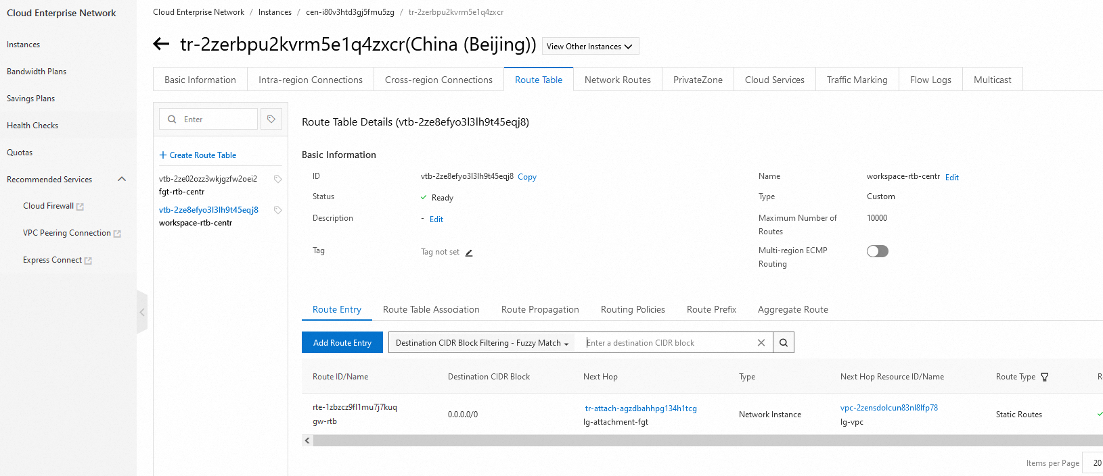
CEN-TR-3

Slide 6
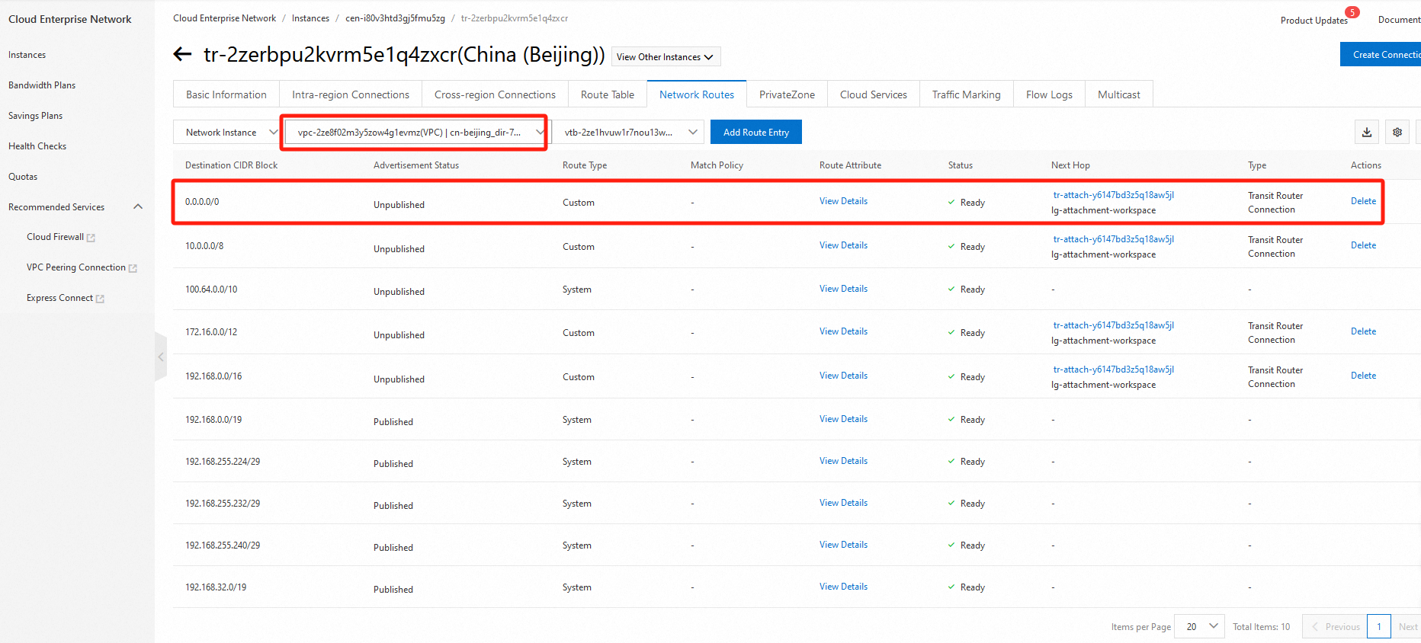
CEN-TR-4
Assign workspace route to CEN-TR

Slide 7
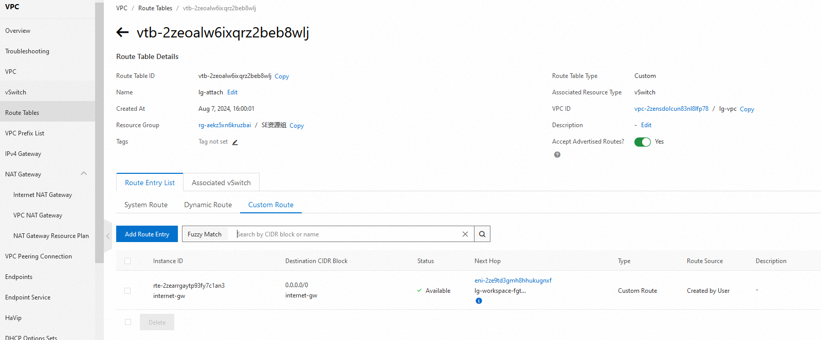
FGT-attach-RTB

Slide 8
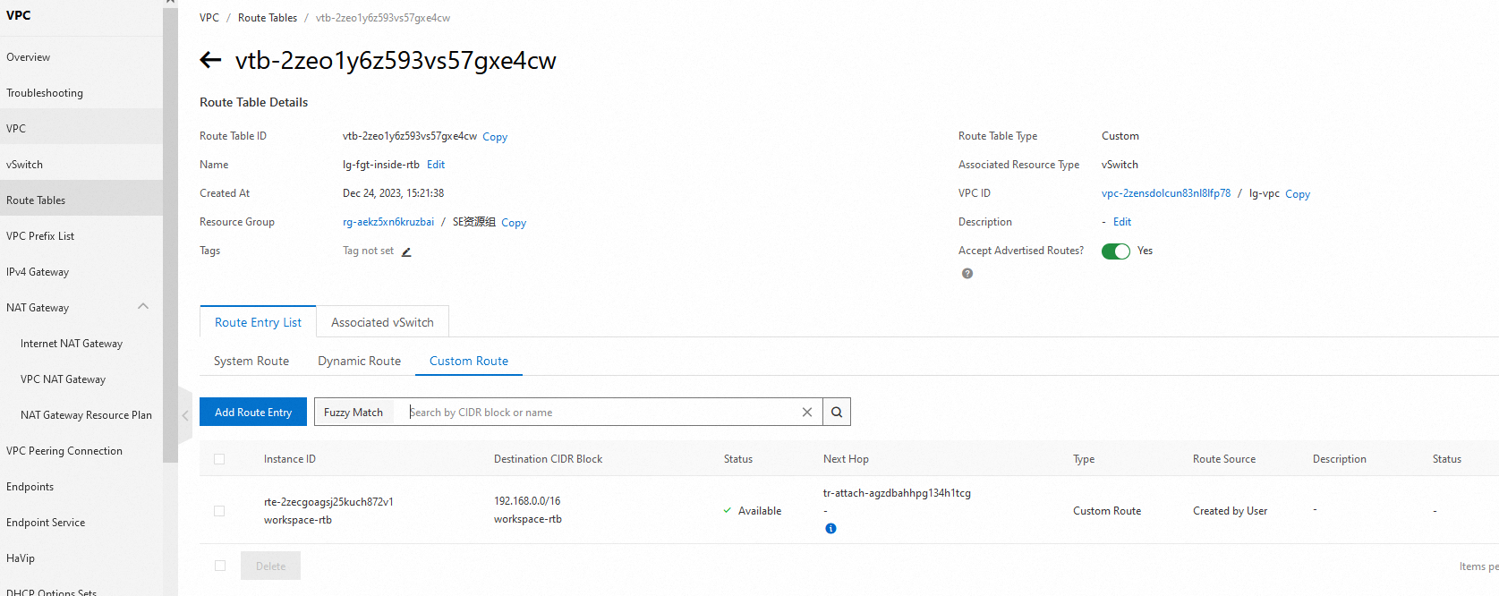
FGT-RTB

Slide 9
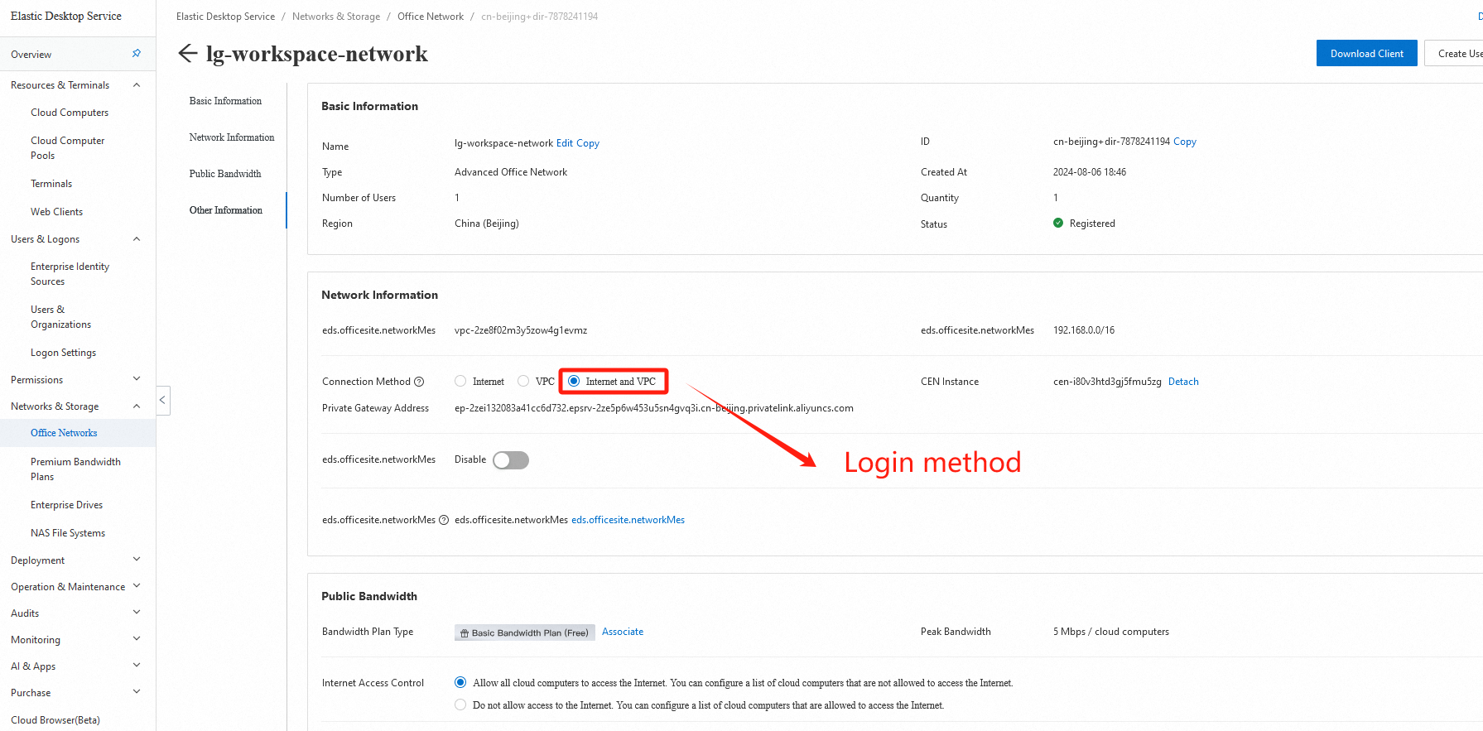
Ali Cloud workspace network setting

Slide 10
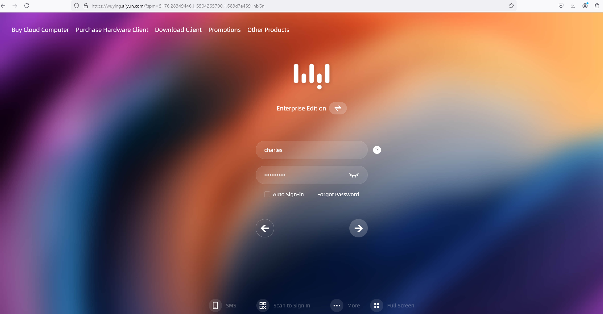
Login info

Slide 11
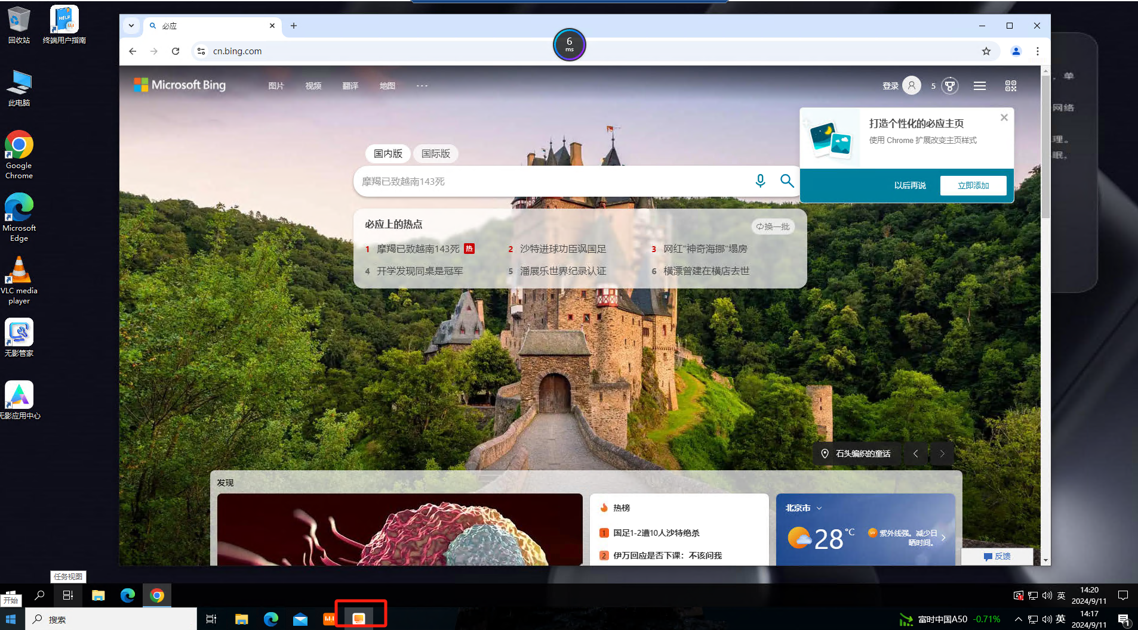
Test-1 log

Slide 12
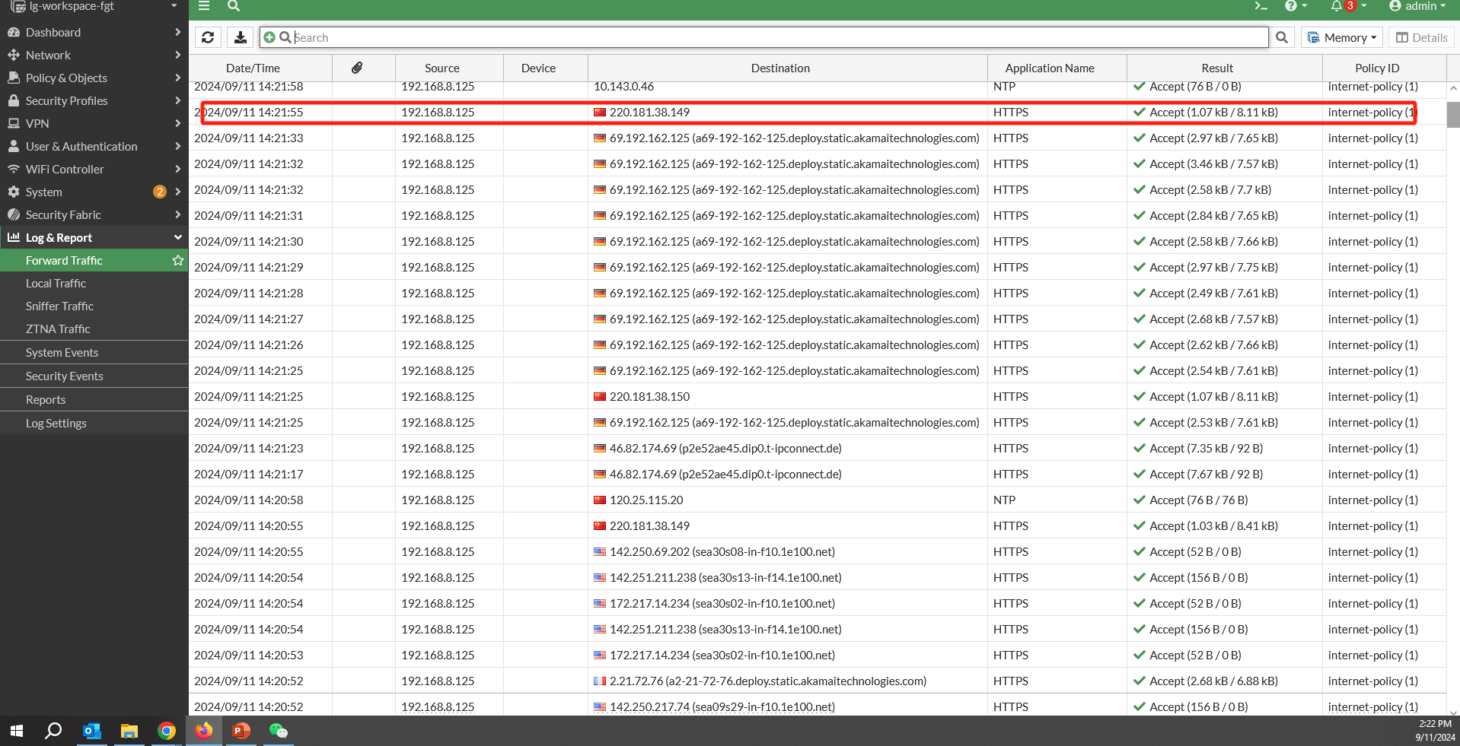
Test-2 log

Slide 13
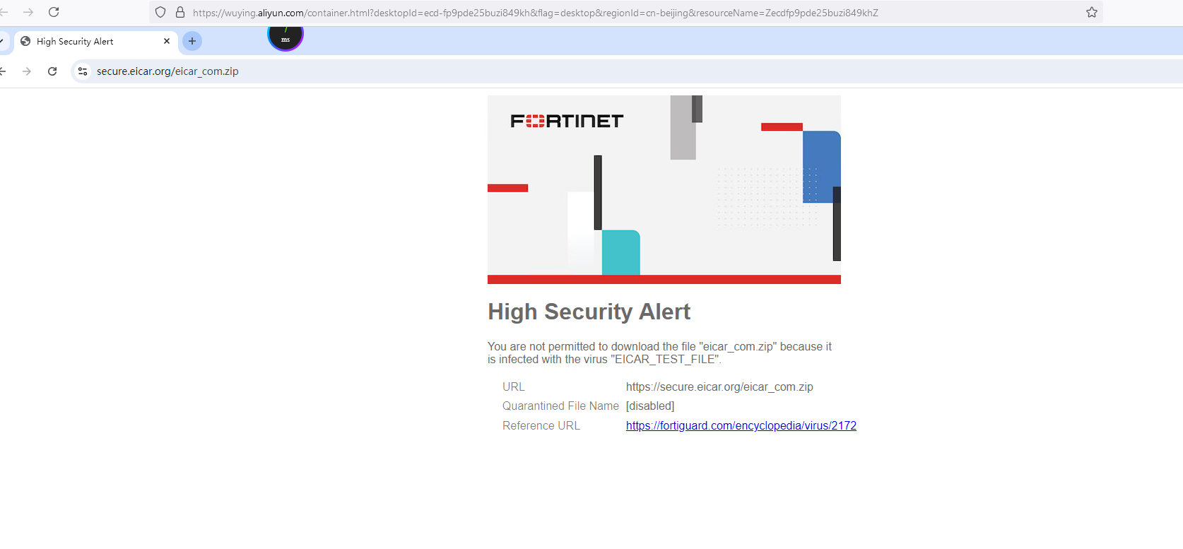
Test-3 log

Slide 14
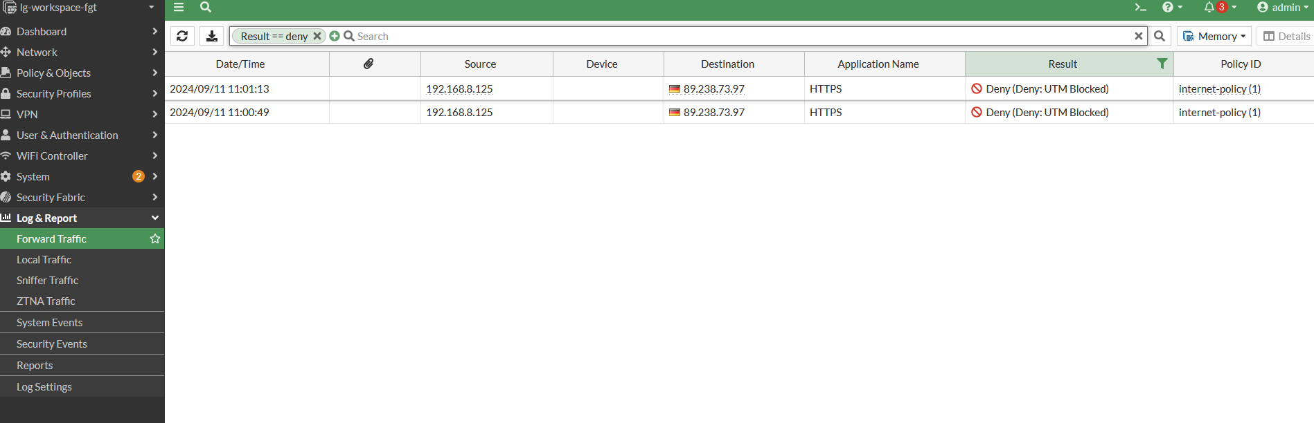
Test-4 log

